Slide 1
R Clinic
Session 15
Model selection and averaging
26/08/2015

Slide 2
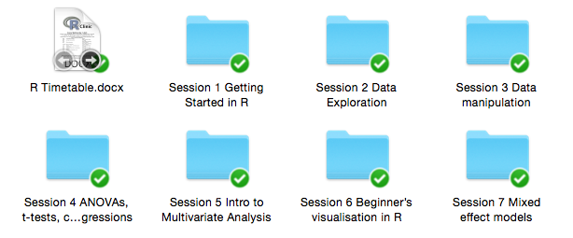
Snippets session
Code and slides added to Dropbox at the beginning of sessions

Slide 3
Upcoming snippets
Writing and exporting documents in R 2nd Sept
Generalised Linear Models for non-normal data distributions 9th Sept

Slide 4
Feedback
Happy to accommodate requests wherever possible
Survey Monkey
Email
In person

Slide 5
Refresher: linear regression
lm()
y ~ x1
y ~ x1 + x2 + x3 + x1*x2 + x1*x3
e.g. using iris data set
model simplification - stepwise

Slide 6
Model simplification
Remove interactions first
Compare models - R2, anova(mod1, mod2)
Remove non-significant variable
Compare models - R2, anova(mod1, mod2)

Slide 7
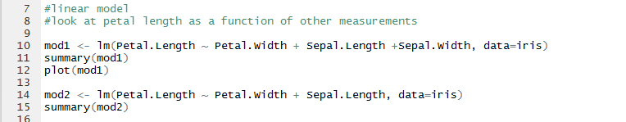
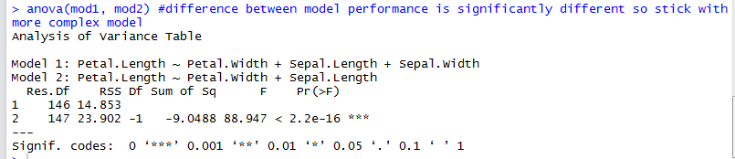
Stepwise simplification

Slide 8
Variable selection
Based on Occam’s Razor philosophy that “all other things being equal the simplest explanation is best”
First, remove variables that have no logical reason to effect the response
Second, remove correlated variables (the model won’t be able to tell which is most appropriate)
Use a statistical approach like all sub-sets model selection or model averaging

Slide 9
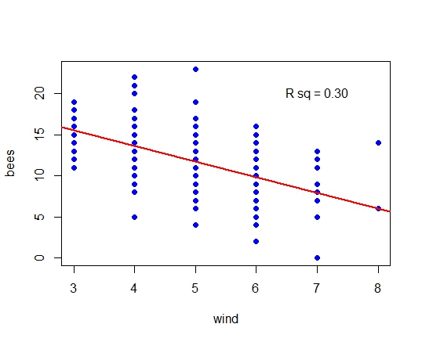
Model selection by AIC
What is a good model?
One which best explains variation in the data
And.. has the fewest variables
R² proportion of variance
explained by the model
AIC = an adjustment to R²
which accounts for number of
parameters in the model
AICc a further adjustment to AIC
for small sample size
Note: other options exist e.g. BIC & DIC

Slide 10
Always
Use common sense to select variables prior and testable hypotheses to select variables before AIC
Remove correlated explanatory variables where possible
State clearly in your “write up” which variables were tested at all stages of model selection

Slide 11
Never
Use AIC with models from different datasets
Use AIC when models have different random variables and different fixed variables

